Slide 1
"I'm less interested in math cause I'm better at languages" roles of SOCIAL-Dimensional comparisons of prior achievement in adolescents’ gendered task value development
Kezia Olive,
Junlin Yu,
Janica Vinni-Laakso,
Katariina Salmela-Aro

Slide 2
Background
SCIENCE
MATH
LANGUAGE
"today's ... performances become tomorrow's past experience“
(Eccles & Wigfield, 2020, p.3)
(Möller & Marsh, 2013,
Wigfield et al., 2020)

Slide 3
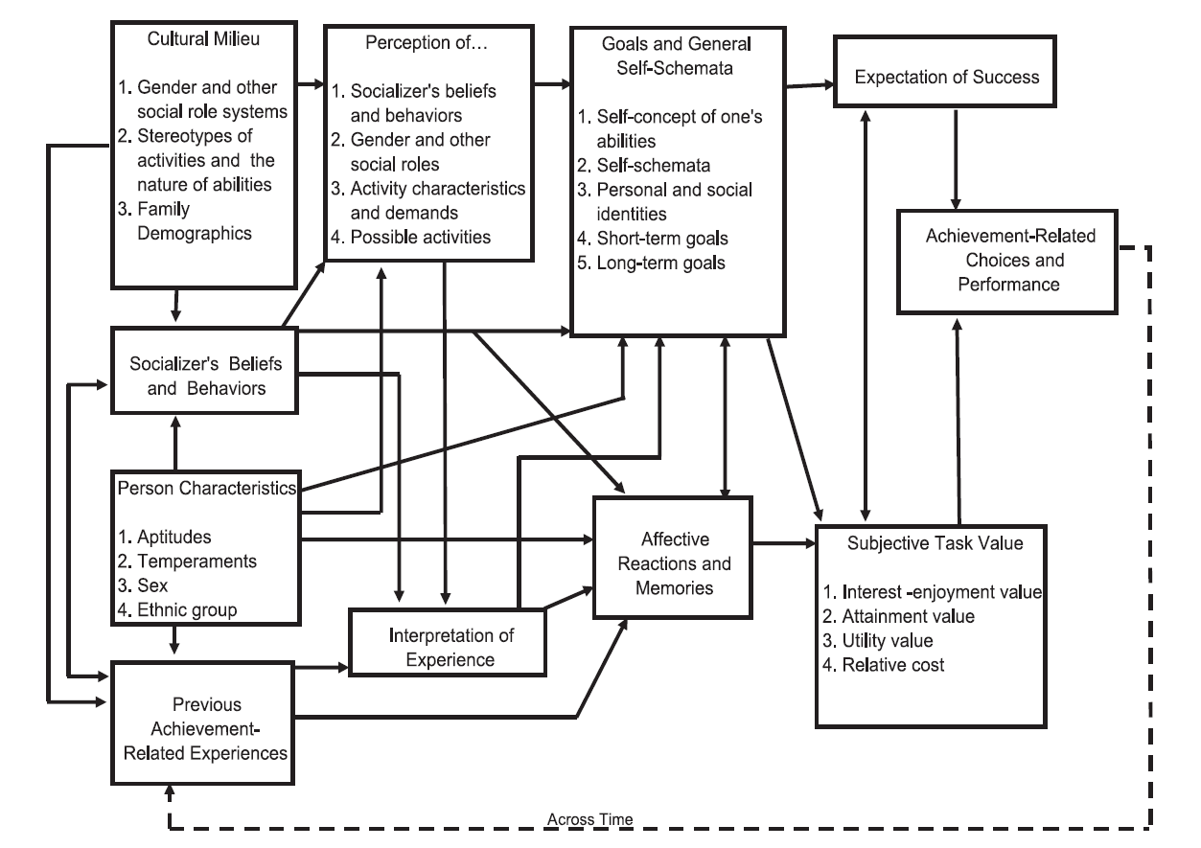
Situated Expectancy Value Theory
3
1
2
(Eccles et al., 1983;
Eccles & Wigfield, 2020)

Slide 4
Research Questions
Q1
Q2
ACHIEVEMENT
VALUES
GENDER
To what extent does past achievement in verbal and math domains influence subsequent STV facets?
How does past achievement influence the development of gendered STV?
Notes:
our study can be an attempt to:
- further study the longitudinal effect of achievement and self concept development
- and the longitudinal effect of achievement on task value development
- see the potential difference process for boys and girls

Slide 5
Hypothesis
Intrinsic • Attainment • Utility • Cost
Q1
Within and cross-domain comparison:
Achievement from the same domains positively affect development of values
Achievement from contrasting domains (math vs verbal) negatively affect development of values
Ach
STV
MATH
Girl
Q2
(Exploratory)
The contributing pathways to gendered values:
Girls and boys differently weigh their achievement across-domain comparison
Girls and boys’ achievement mediate the gender-value relationship
Ach
STV
FINNISH
Intrinsic • Attainment • Utility • Cost

Slide 6
GROWING MIND DATA
GRADE 8
int
GRADE 7
Cohort 7 | Waves A, B
Ach
att-ut
1
ACHIEVEMENT
MATH
Grade 7 (M age = 12.8)
N=1352
cost
2
STV
Girl
(Finnish, Math & Physics)
Grade 8
int
3
GENDER
Girls (52%) and boys (45%)
Ach
att-ut
FINNISH
?
MODEL & MEASUREMENT
cost
Structural Equation Modeling

Slide 7
To what extent does past achievement in verbal and math domains influence subsequent STV facets?
GRADE 8
Q1
.45
int
GRADE 7
Ach
.34
att-ut
MATH
ACHIEVEMENT
VALUES
-.34
cost
-.14
.12
int
Higher achievement: higher intrinsic & attainment-utility value, but lower cost for the matching subject.
Higher Finnish grades: less interest and higher cost in math
.20
Ach
.20
att-ut
FINNISH
-.32
cost
Notes:
Standardize the range to help visualizing the real differences

Slide 8
How does past achievement influence the development of gendered STV?
GRADE 8
Q2
int
GRADE 7
.41
Ach
.34
att-ut
MATH
GENDER
.13
-.31
cost
-.17
Girl
.20
Gender does not change the strength and direction of the relationship
Gender directly influence value above and beyond dimensional comparison of achievement
int
.26
.31
Ach
.20
att-ut
FINNISH
-.35
cost

Slide 9
Knowing the process..
Students develop their beliefs by evaluating their previous achievement
Their achievement from different subjects matters!
What other sources of comparison processes might take place?
If gendered values develop above and beyond comparison of achievement, what else might be involved?
How does this inform teachers, schools, regulations?

Slide 10
Let’s have more discussions!
kezia.olive@helsinki.fi
@KeziaOlive911

Slide 11
References & CREDITS
Eccles, J. S., Adler, T. F., Futterman, R., Goff, S. B., Kaczala, C. M., Meece, J. L., & Midgley, C. (1983). Expectancies, values, and academic behavior. In J. T. Spence (Ed.), Achievement and Achievement Motives (pp. 75–138). W. H. Freeman and Company.
Eccles, J. S., & Wigfield, A. (2020). From expectancy-value theory to situated expectancy-value theory: A developmental, social cognitive, and sociocultural perspective on motivation. Contemporary Educational Psychology, 61, 101859. https://doi.org/10.1016/j.cedpsych.2020.101859
Gaspard, H., Wigfield, A., Jiang, Y., Nagengast, B., Trautwein, U., & Marsh, H. W. (2018). Dimensional comparisons: How academic track students’ achievements are related to their expectancy and value beliefs across multiple domains. Contemporary Educational Psychology, 52, 1–14. https://doi.org/10.1016/j.cedpsych.2017.10.003
Möller, J., & Marsh, H. W. (2013). Dimensional comparison theory. Psychological Review, 120(3), 544–560. https://doi.org/10.1037/a0032459
Olive, K., Tang, X., Loukomies, A., Juuti, K., & Salmela-Aro, K. (2022). Gendered difference in motivational profiles, achievement, and STEM aspiration of elementary school students. Frontiers in Psychology, 13, 954325. https://doi.org/10.3389/fpsyg.2022.954325
Wang, M.-T., & Degol, J. L. (2017). Gender Gap in Science, Technology, Engineering, and Mathematics (STEM): Current Knowledge, Implications for Practice, Policy, and Future Directions. Educational Psychology Review, 29(1), 119–140. https://doi.org/10.1007/s10648-015-9355-x
Wigfield, A., Eccles, J. S., & Möller, J. (2020). How Dimensional Comparisons Help to Understand Linkages Between Expectancies, Values, Performance, and Choice. Educational Psychology Review, 32(3), 657–680. https://doi.org/10.1007/s10648-020-09524-2
This project has received funding from the European Union’s Horizon 2020 research and innovation programme under the
Marie Skłodowska-Curie grant agreement No 953326.
Boy icons created by Freepik – Flaticon
Idea icons created by Freepik - Flaticon
Review icons created by Aldo Cervantes – Flaticon
School-elements-black-line-icon designed by ibrandify - Freepik
Thumbs up icons created by vectorspoint - Flaticon

