Slide 1
DIMENSIONAL COMPARISON & GENDERED ACADEMIC BELIEFS OF PARENTS AND ADOLESCENTS
Kezia Olive*
Junlin Yu
Katariina Salmela-Aro
*(kezia.olive@helsinki.fi)
Andrea Kočiš
Harriet Tenenbaum
This project has received funding from the European Union’s Horizon 2020 research and innovation programme under the Marie Skłodowska-Curie grant agreement No 953326
Notes:
parents may get to know the achievements of their children in multiple subjects, and then infer what are the things that their child is good at -- and this may be a potential pathway through which they start to encourage their child to go more towards a subject, maybe it also nudge them to think that their child should put more importance and value into a certain field cause it's more useful, etc.
I think this is logical, but we should test it.
Especially since theoretically, we have been assuming that this is the case.

Slide 2
BACKGROUND
SCIENCE
MATH
LANGUAGE
"today's ... performances become tomorrow's past experience“
(Eccles & Wigfield, 2020, p.3)
(Möller, 2016;
Möller & Marsh, 2013;
Wigfield et al., 2020)
Notes:
We know from expectancy value theory that today's experience, such as a student's academic performance, become tomorrow's past experience, which is another starting point of developing self-concept of ability or expectancies (will I succeed in this task/subject?) and also values (how much do I find this task/subject enjoyable, important for myself, useful for my future, or just plain exhausting and taxing?).
We know already from several past studies that indeed, students' achievement influence their self-concept of ability and values, to a certain extent. But does it influence parents the same way?

Slide 3
BACKGROUND
Gender stereotypical academic beliefs seemingly increase with children’s age --
do adolescent students’ academic performance influence parents’ (gendered) beliefs?
(Jacobs & Eccles, 1992;
Räty 2003; Frome & Eccles, 1998)
Notes:
We know from past studies that parents' gender stereotypical beliefs, such as that boys are better in math-related subjects and girls in language, for example, seem to increase with children's age. But is it influenced by their observation of their child's achievement?

Slide 4
GENERALIZED I/E MODEL
(Prior)Ach
Ability
+
MATH
Values
POSITIVE
WITHIN-DOMAIN
Intrinsic • Attainment Utility • Cost
-
Girl
NEGATIVE
CROSS-DOMAIN
-
Values
FINNISH
(Prior)Ach
Ability
+
Intrinsic • Attainment Utility • Cost
(Möller, 2016;
Möller & Marsh, 2013;
Van Zanden et al, 2017)
Notes:
On top of that, informed by the theoretical framework from Generalized Internal/External frame of reference, we get to know that most students (and socializers) seem to build this framework of math-language continuum: they are seen as very contrasting to one another, and they do different types of comparisons.
When they look at within-domain comparison, usually this results in positive relationship, meaning that, say, higher achievement in math would lead the student to believe "yes I am better in math!" and the same way for higher achievement in language.
But they also do cross-domain comparisons, which usually leads to negative relationship, meaning that they would think "oh, my language achievement is higher than my math achievement -- I like math less."
Perhaps this also counts for parents when developing the thought about whether their child have high ability in a field? (this has been observed in a past study)
and perhaps also influencing them in thinking about what subject might be more useful and important for their child?
and provide a new pathway from which we can examine how the effect of gender comes into play in these relationship?

Slide 5
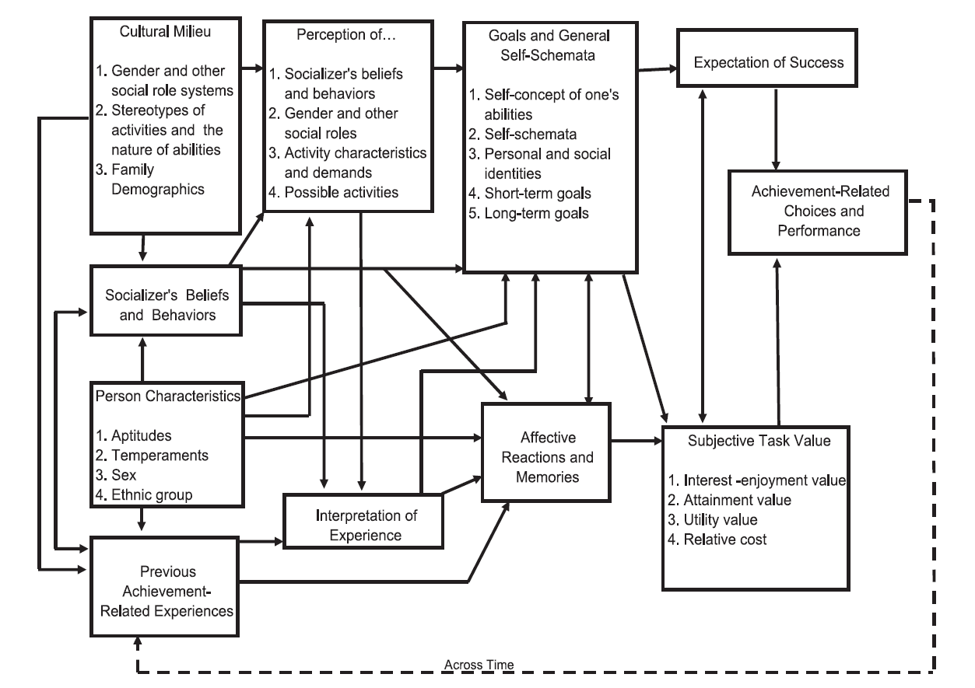
Situated Expectancy Value Theory
1
3
2
(Eccles et al., 1983;
Eccles & Wigfield, 2020)

Slide 6
Research Questions
To what extent do adolescents’ achievement and gender associate to their parents’ (academic) beliefs about them?
To what extent does it align with the students’ own associations?
Notes:
With this framework in mind, we want to know to what extent do adolescents' achievement and gender associate to their parents' academic beliefs about them (this includes beliefs about ability and subjective task value);
and to what extent does this align with the students' own associations? (Are the associations comparable between what the students perceive and what the parents do?)

Slide 7
(Prior)Ach
Ability
+
MATH
Values
PARENTS
Intrinsic • Attainment Utility • Cost
-
Moms (885); Dads (204)
Girl
ADOLESCENTS
Grade 8 & 10
Girls (487); Boys (404)
-
METHODS
GENDER (CHILD)
Values
Girls (487); Boys (404)
FINNISH
MODEL & MEASUREMENT
(Prior)Ach
Ability
+
Structural Equation Modeling
Testing GI/E patterns
Intrinsic • Attainment Utility • Cost
Notes:
We did this by utilizing data collected from the longitudinal Finnish data collection in Helsinki, Finland;
both parents and adolescents from grade 8 and 10 who have been part of this data collection for a while, were given questionnaires.
Parents were asked about their perception of the child's ability in both math and finnish, and also whether they see these subjects as important or useful for their child.
Students were also asked about their perception of their own ability in both subjects, and how much they enjoy it, see it as important, and useful.
We also asked about their gender, and we collected the students' achievement data from the previous year (when they were in grade 7 and grade 9) from schools.
We modeled this to test the relationship pathways that were described by GI/E (positive within-domain and negative cross-domain), while also testing the influence of the child's gender.

Slide 8
(Prior)Ach
.64
Ability
.43
MATH
Importance
PARENTS
Parents of students with high math achievement:
believe their child also have higher ability in language
Parents of daughters:
their child have less ability in math
believe math is less important for their child
How does that compare to the children?
-.08
Girl
-.11
.14
RESULTS
.37
Importance
FINNISH
(Prior)Ach
Ability
.47
Notes:
First, from the parents, we look at how their children's achievement associate with their perception of the child's ability and how much they think this subject is important and useful, and we do see positive within-domain relation, so higher achievement either in math or finnish is associated with higher belief that their child is good at it, but only in math we see also it affecting the belief that math is important for their child.
In terms of cross-domain, though: it is not negative! parents of students with high math achievement believe that their child also have higher ability in language. Seems like some sort of halo effect -- if you're good at math, you're most likely good at Finnish too?
and when we look at the effect of gender, we see that parents of daughters believe their daughtes have less ability in math and that it is less important or useful for their daughters.
Script: Model_2-1

Slide 9
Ability
.53
(Prior)Ach
.36
Importance
.44
MATH
Intrinsic
-.20
.08
ADOLESCENTS
-.23
-.14
Cost
Students with high math achievement believes that they have lower ability in language, and value it less
Girls:
tend to report lower ability beliefs;
enjoy math less but find language important and not difficult
Girl
.26
.19
.08
Cost
.10
-.22
RESULTS
.31
-.12
-.10
Intrinsic
FINNISH
-.31
-.21
(Prior)Ach
.34
Importance
.27
.51
Ability
Notes:
How does this compare to the children's own perceptions?
We see that for these adolescents, within-domain comparison indeed warrants that they feel more confident in their ability, and also value it more and hate it less. On the other hand, we see cross-domain comparison only from math: students with higher math achievement believe that they have lower ability in language, and value it less. Even think of it as more costly and taxing.
To a certain extent, the patterns are similar to what GI/E described. But not in all pathways. But also, these perceptions are quite different from what their parents reported.
Moreover, we see that girls, although having in general higher achievement, tend to report lower ability beliefs, in both subjects, regardless of their previous achievment. They also enjoy math less, but dinf language important and not difficult.
Script: Model_gie.out

Slide 10
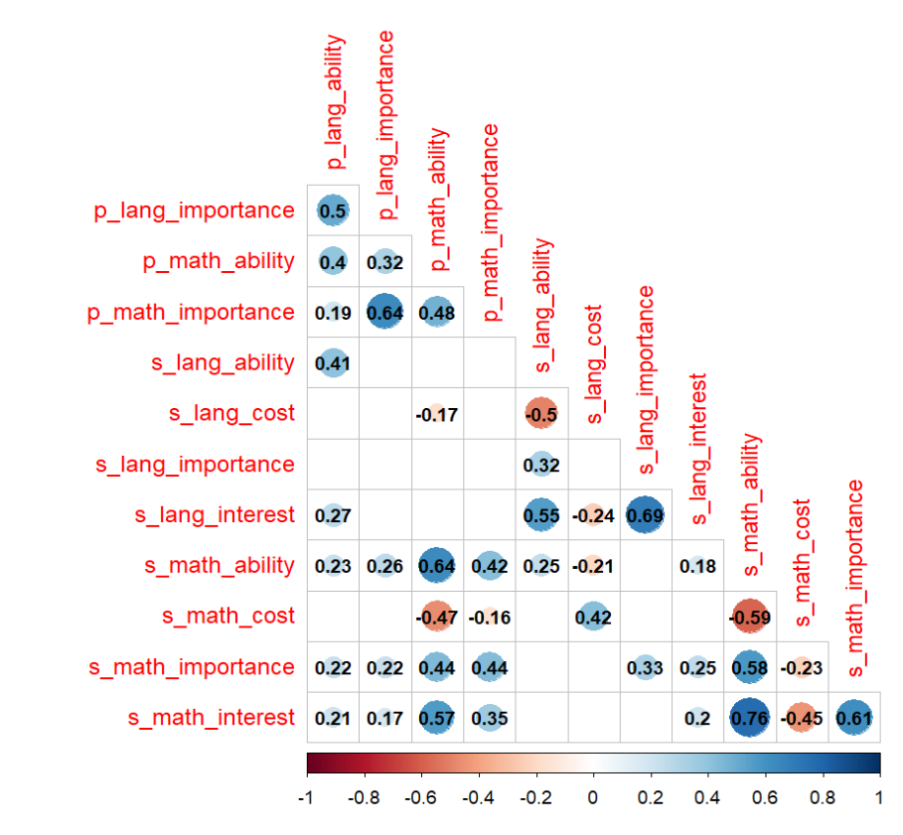
ADOLESCENTS
RESULTS
Beliefs are associated with their parents’
Especially related to math
Notes:
When we look at correlations between the students and the parents' beliefs, we can see that their beliefs are associated mostly for math, or in pathways where we see simlar patterns between parents and child.

Slide 11
Implications
When forming their values and infer about their child’s ability, parents did not compare their child’s achievement as GI/E predicted
more likely adopting gender stereotypes?
Adolescents do compare their achievements following GI/E pattern to form their values and self-concept of ability,
but also influenced by gendered factors beyond achievement
Achievement experiences have a big influence on students
– but parents and adolescents do not rely only on comparing achievements
when forming their values and ability beliefs
Adolescents potentially compare their parents’ beliefs?
Potential influence of important moderators (e.g., quality of parent-child relationship)?
Thank you! Contacts & more info on my work: https://keziaolive.github.io/
Notes:
Taking these results together, we get to see that unlike what we expect from usual GI/E patterns,
when forming their values and infer about their child's ability, parents did not compare their child's achievement as GI/E predicted. Perhaps they are already more likely to adopt gender stereotypes as they look at other influences outside of their child's performance? or is it that this process started way earlier and we could not capture it well enough in this study?
On top of that, adolescents do compare their achievement following GI/E pattern, but seem to also be influenced by gendered factors beyond achievement.
We see that achievement experiences have a big influence on students.
But both parents and adolescents do not seem to rely only on achievement comparisons when forming their values and ability beliefs.
The gendered factor -- Is it that adolescents potentially use GI/E framework to compare their parents' (or other socializers') beliefs, rather than achievement?
We can know more if we have perhaps more longitudinal studies on this?
On top of that, perhaps the quality of the relationship between the child and the parents or whoever the socializer we talk about is, really moderate the effect as well? I can imagine that students with good relationship with their parents, with high relatedness and autonomy need satisfaction, perhaps would have different magnitude and direction for the effect of these comparisons?
We don't know, but this is a good starting point to continue that journey and discover more about how to support adolescents' developing values and identify genderedness.

Slide 12
References & Acknowledgements
Eccles, J. S., Adler, T. F., Futterman, R., Goff, S. B., Kaczala, C. M., Meece, J. L., & Midgley, C. (1983). Expectancies, values, and academic behavior. In J. T. Spence (Ed.), Achievement and Achievement Motives (pp. 75–138). W. H. Freeman and Company.
Eccles, J. S., & Wigfield, A. (2020). From expectancy-value theory to situated expectancy-value theory: A developmental, social cognitive, and sociocultural perspective on motivation. Contemporary Educational Psychology, 61, 101859. https://doi.org/10.1016/j.cedpsych.2020.101859
Fredricks, J. A., & Eccles, J. S. (2005). Family socialization, gender, motivation, and competitive sports involvement. Journal of Sport & Exercise Psychology, 27, 3–31
Frome, P. M., & Eccles, J. S. (1998). Parents' influence on children's achievement-related perceptions. Journal of Personality and Social Psychology, 74(2), 435–452. https://doi.org/10.1037/0022-3514.74.2.435
Jacobs, J. E., & Eccles, J. S. (1992). The impact of mothers' gender-role stereotypic beliefs on mothers' and children's ability perceptions. Journal of Personality and Social Psychology, 63(6), 932–944. https://doi.org/10.1037/0022-3514.63.6.932
Möller, J. (2016). The generalized internal/external frame of reference model: An extension to dimensional comparison theory. Frontline Learning Research, 4(4), 1–11. https://doi.org/10.14786/flr.v4i2.169
Möller, J., & Marsh, H. W. (2013). Dimensional comparison theory. Psychological Review, 120(3), 544–560. https://doi.org/10.1037/a0032459
Simpkins, S. D., Fredricks, J. A., & Eccles, J. S. (2012). Charting the Eccles’ expectancy-value model from mothers’ beliefs in childhood to youths’ activities in adolescence. Developmental Psychology, 48(4), 1019–1032. https://doi.org/10.1037/a0027468
Wigfield, A., Eccles, J. S., & Möller, J. (2020). How Dimensional Comparisons Help to Understand Linkages Between Expectancies, Values, Performance, and Choice. Educational Psychology Review, 32(3), 657–680. https://doi.org/10.1007/s10648-020-09524-2
This project has received funding from the European Union’s Horizon 2020 research and innovation programme under the
Marie Skłodowska-Curie grant agreement No 953326.
Boy icons created by Freepik – Flaticon
Idea icons created by Freepik - Flaticon
Review icons created by Aldo Cervantes – Flaticon
School-elements-black-line-icon designed by ibrandify - Freepik
Thumbs up icons created by vectorspoint - Flaticon

Slide 13
Parents’ (academic) beliefs
"How good is this child at math [Finnish]?"
"Compared with other children, how much talent does this child have in math [Finnish]?“
"How well do you think this child will do in math [Finnish] next year?"
"How important is it to you that this child does well in math [Finnish]?"
"How useful do you think math [Finnish] will be to this child in the future?"
(Fredricks & Eccles, 2005,
Simpkins et al, 2012)
Students’ (academic) beliefs
“Math [Finnish] is important to me”
“Math [Finnish] is useful for me”
“Math [Finnish] is interesting to me”
“I feel I’m good at Math [Finnish]”
“Math [Finnish] is easy for me”
“Math [Finnish] is exhausting me”
(Eccles & Wigfield, 1995)
Notes:
To address these research questions, we will utilize a subset of data collected from the Growing Mind project, an ongoing longitudinal data collection based in Helsinki, Finland. We collected questionnaire data from parents and their adolescent students, measuring parents’ beliefs (perceptions of children’s ability in math and verbal domains alongside perception of importance and efficacy in each domain)

